Slide 1

DXC Techno-Thon’26 Solution Title
Solution Presentation
Team Name: The Future Forge

Slide 2
Business Impact of the solution
Weight: 20%
Clear articulation of how the solution improves revenue, cost, or efficiency
Problem Statement:
Healthcare Sector Government Scheme Utilization & Healthcare Access Analytics
Governments allocate significant budgets to public healthcare schemes aimed at improving access, affordability, and health outcomes. Despite this investment, utilization and impact vary widely across regions and population segments. Policymakers lack an integrated, data-driven view to assess how effectively schemes are being adopted.
An industry-grade healthcare analytics business case focused on evaluating government health schemes and policies, with multi-level drill-down (country → state → district → city), and also how people access healthcare and treatment for diseases.
Background & Problem Statement
Governments invest heavily in public healthcare schemes (insurance programs, free treatments, preventive care initiatives, disease-specific programs). However, there are persistent challenges:
Low or uneven utilization of schemes
Regional disparities in healthcare access
Lack of visibility into who benefits, who doesn’t, and why
Difficulty linking policy impact to actual health outcomes
Poor understanding of disease-wise treatment adoption
Policies and Decision makers, Administrators need a data-driven framework to analyse policy effectiveness and healthcare behaviour at multiple geographic levels.

Slide 3
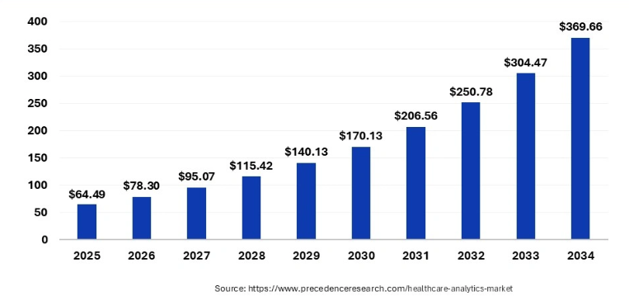
Business Potential
Weight: 20%
Objective of the Use Case
To build a Healthcare Policy & Utilization Analytics Platform that:
Measures adoption and effectiveness of government healthcare schemes
Analyzes healthcare access and treatment patterns for major diseases
Enables drill-down analysis from national → state → district → city
Supports policy optimization, funding allocation, and targeted interventions
Stakeholders
Ministry of Health / Health Departments
Global healthcare analytics market: $64–91B (2025) – Increasing Investment Opportunity: 25–30%
Public Hospitals & Primary Health Centres (PHCs) - Opportunity: 25–30%
Healthcare & Life Science product Industries - 14.9B (2024) to $110B by 2030
Insurance Authorities (e.g., public health insurance bodies)
Pharmacitical Industries – Real world evidence opportunity: 10–15%
Policy Makers & Planners
NGOs & Public Health Researchers - Opportunity: 5–10%
Key Government Schemes Covered (Examples)
Public Health Insurance Schemes
Maternal & Child Health Programs
Immunization Programs
Chronic Disease Programs (Diabetes, Cancer, TB, Cardiac)
Senior Citizen & Low-Income Health Benefits
Preventive Health & Wellness Schemes
KPIs & Dashboards
National Health Dashboard
Scheme Utilization & Effectiveness
Awareness vs Enrolments Analysis
Disease-Wise Treatment
Budget Allocation & Policy Effectiveness Summaries
Auto-generated status reports
Healthcare Analytics projected to reach $198B–$369B+ by early 2030s

Slide 4
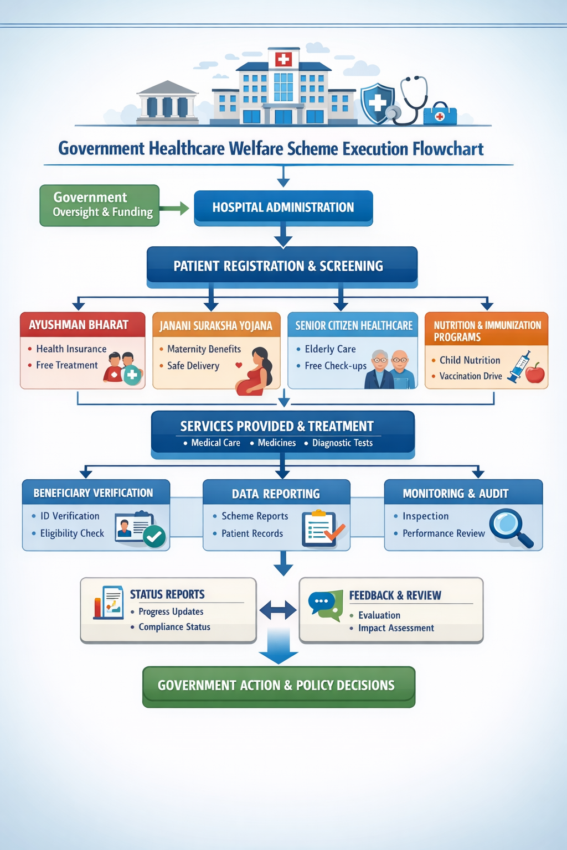
Client/Industry Relevance
Weight: 20%
Alignment with real-world client challenges and industry context
Value Delivered
For Policymakers
Clear visibility into what works and what doesn’t
Data-backed funding and policy decisions
Move from reporting to insight
For Health Departments
Better targeting of awareness campaigns
Enable outcome-driven healthcare governance
Optimized infrastructure and workforce planning
For Citizens
Improved access to affordable healthcare
Reduced delays and financial burden
Implementation Roadmap (High-Level)
Estimated share opportunity: 25–30% of analytics implementation market
Phase 1: Data integration & governance
Phase 2: Analytics & dashboards
Phase 3: Advanced insights & AI
Future Enhancements
AI-driven disease outbreak prediction
Personalized scheme recommendation for citizens
Mobile dashboards for district officers
Integration with wearable & preventive health data

Slide 5





Technology And Architecture
Weight: 20%
< Provide a diagrammatic view of the Architecture for the proposed solution calling out the key technology components >
Advance Analytics
Summary
Forecasting
Budgeting
Audit
Reconciliation
Technology Architecture & Flow Chart
Source Data
Oracle APEX
Cohere AI
Summarized Data
Data Analytics
Legacy Systems SaaS | ERP | AWS | Cloud etc.
Data Mapping
Analytics & Ddashboard
Cohere API

Slide 6
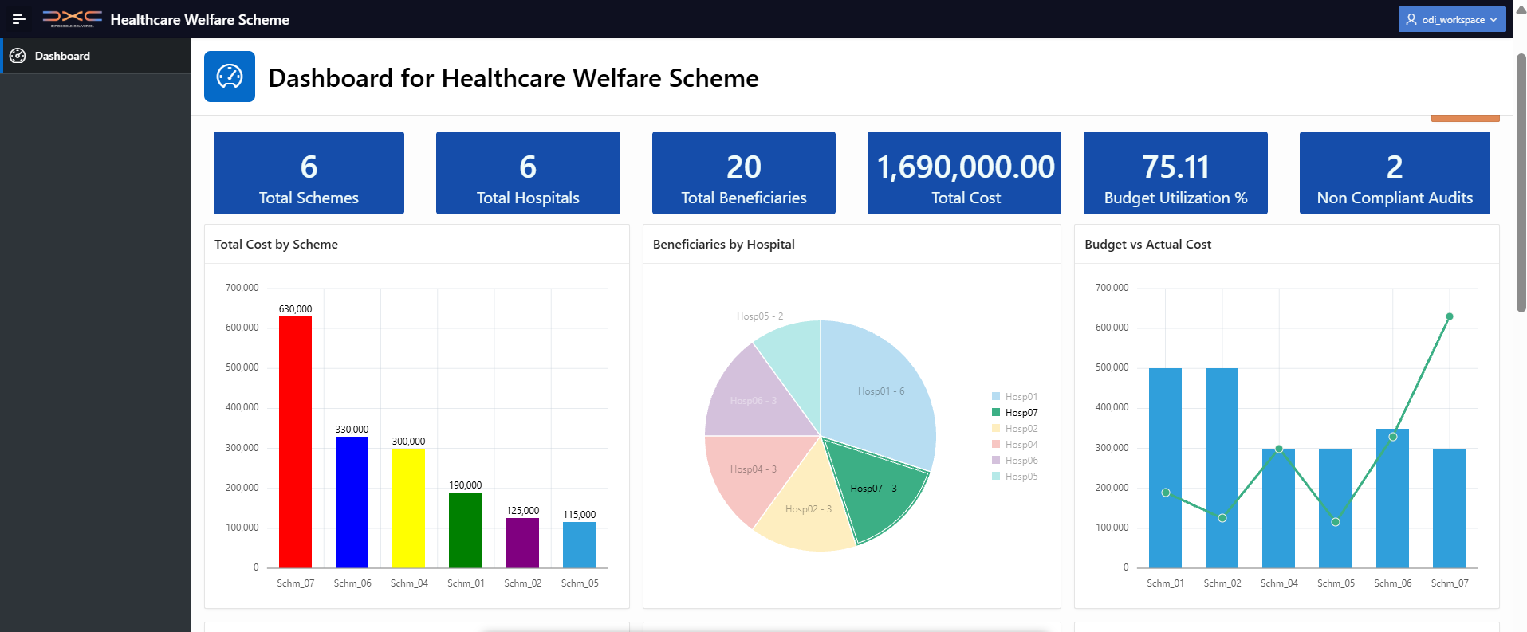
Technology And Architecture
Weight: 20%
< Provide a diagrammatic view of the Architecture for the proposed solution calling out the key technology components >

Slide 7
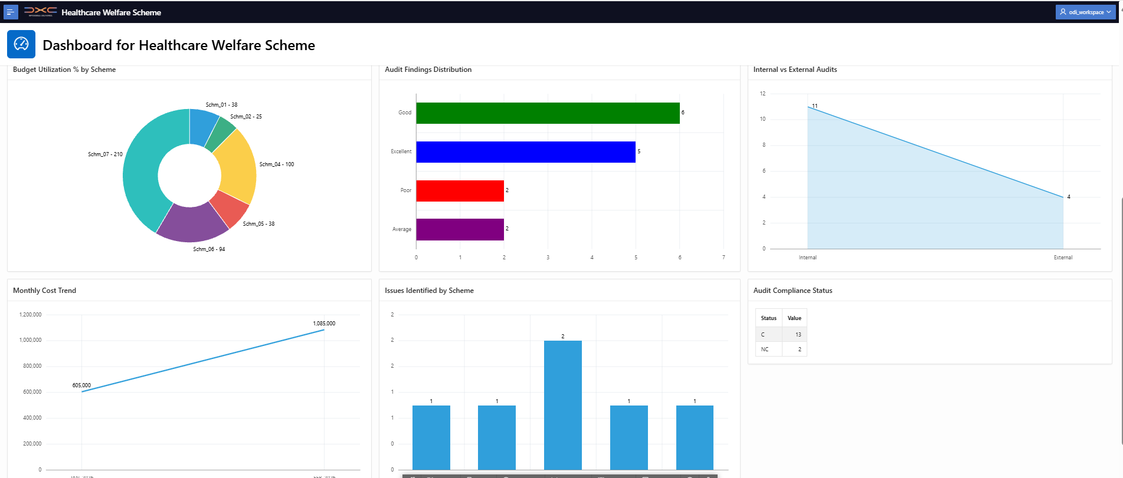
Technology And Architecture
Weight: 20%
< Provide a diagrammatic view of the Architecture for the proposed solution calling out the key technology components >

Slide 8
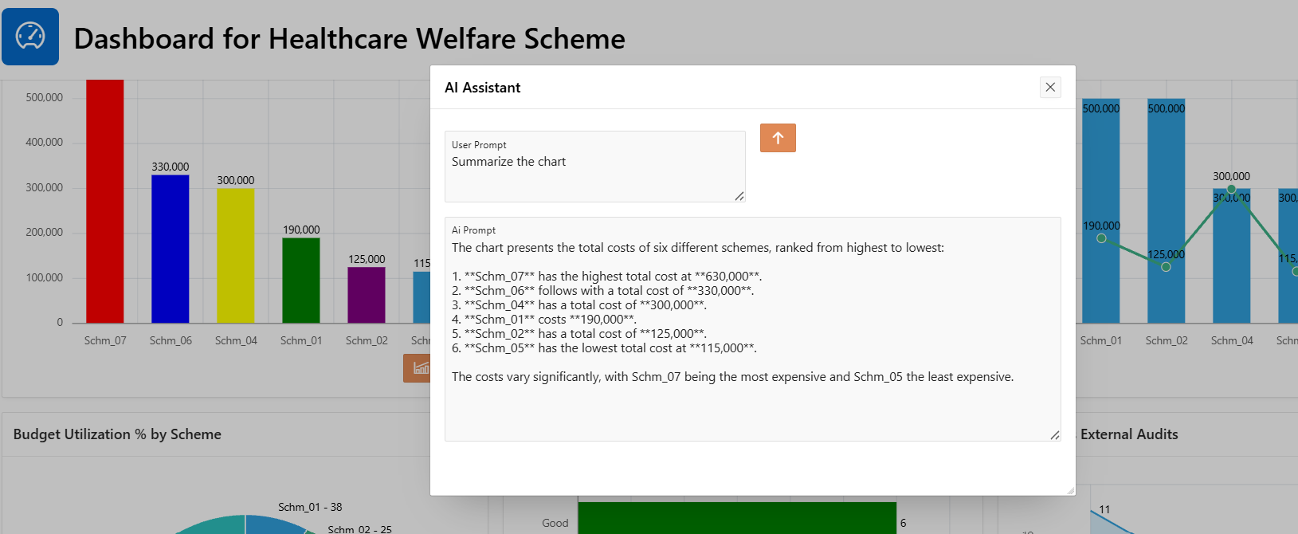
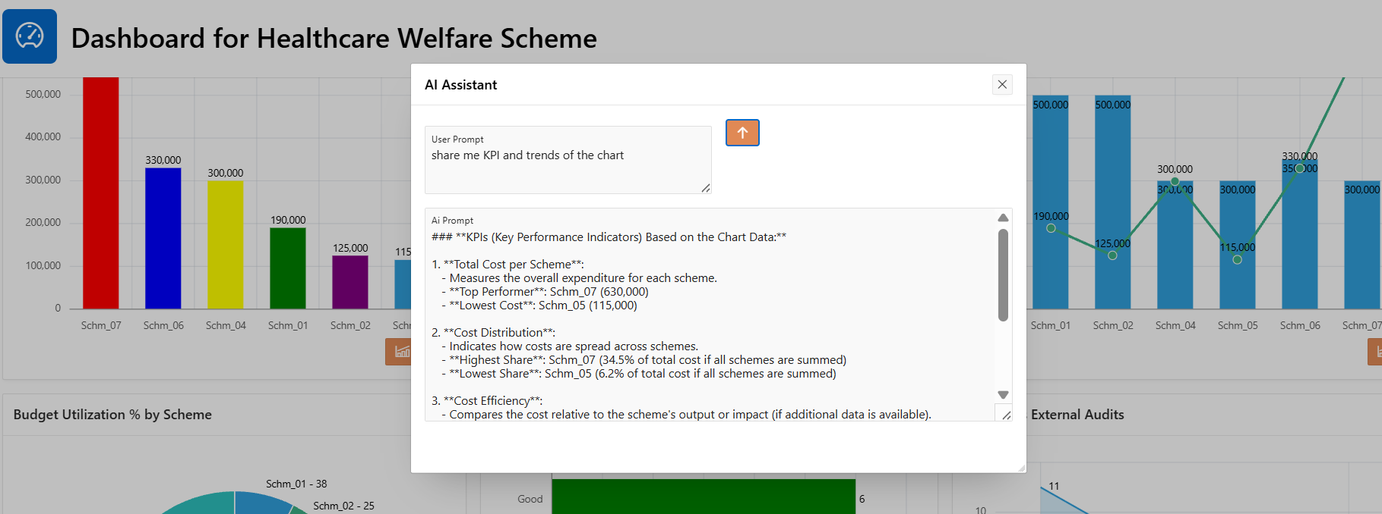
Technical Innovation
Use of GenAI/Agentic AI in a novel, effective, and technically sound way
This solution stands out because it combines policy-centric analytics, multi-level geographic insight, responsible Cohere AI, Interactive AI with Dashboard chart, and low-code scalability into a single platform. Unlike existing solutions that analyze fragments of the problem, it delivers a holistic, explainable, and governance-ready system purpose-built for public healthcare decision-making at national scale.
Chart Summarization by
AI Agent

Slide 9
Working Prototype
Weight: 10%
Functionality, completeness, and clarity of the PoC/demo
This working prototype demonstrates an industry-grade Healthcare Policy & Utilization Analytics Platform designed to help government policymakers and administrators evaluate the adoption, effectiveness, and impact of public healthcare schemes. The solution integrates Oracle APEX dashboards with GenAI-powered analytics (Cohere/OpenAI) to deliver actionable, data-driven insights.
The PoC shows the capability of multi-level geographic drill-down (national → state → district → city) to analyze scheme utilization, healthcare access gaps, and disease-wise treatment patterns. Interactive dashboards provide clear visibility into regional disparities, beneficiary coverage, and operational performance, addressing key challenges of uneven utilization and limited policy visibility.
A GenAI Summarization Agent converts complex analytics into decision-ready insights, including automated scheme performance summaries, district-level briefs, and policy impact reports. This significantly reduces manual analysis and accelerates informed decision-making.
The prototype is functionally complete for core analytics and AI-driven summarization, with a clear roadmap for enhancement through a Conversational “Seeking” Agent that will enable natural-language exploration of healthcare data.
Overall, the PoC clearly demonstrates technical feasibility, business value, and scalability, validating its potential as a powerful platform for policy optimization, targeted interventions, and data-driven governance in public healthcare.

Slide 10
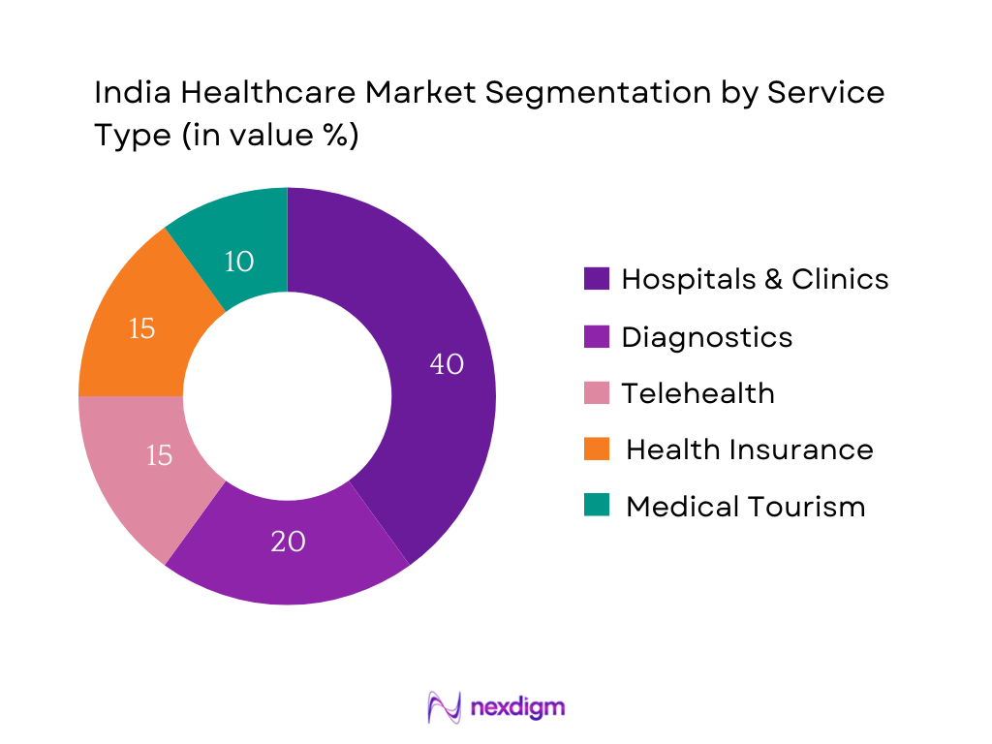
Responsible AI & Scalability
Weight: 10%
Consideration of ethics, governance, and potential for enterprise deployment
This solution demonstrates a responsible, ethical, and scalable application of AI in public healthcare analytics. By combining Oracle APEX dashboards with controlled GenAI capabilities, it delivers high-value insights while maintaining data privacy, governance, transparency, and compliance. The PoC validates readiness for enterprise-scale deployment and establishes a strong foundation for trusted, AI-enabled healthcare policy decision-making.
Scalability and Enterprise Deployment Readiness
The solution is built with enterprise scalability and long-term adoption in mind.
Scalable architecture Oracle APEX provides a robust, scalable foundation capable of supporting large datasets, multiple regions, and increasing user volumes without re-architecting the solution.
Modular AI integration The GenAI with Cohere agent framework (Summarization and Seeking Agents) is modular, allowing additional AI capabilities to be added without impacting core analytics.
Multi-tenant and multi-agency readiness The platform can support multiple schemes, departments, or agencies through configurable data models and role-based access.
Future-ready expansion The conversational “Seeking” Agent can be safely enabled once governance, validation, and usage policies are fully established.

Slide 12
DXC techno-thon’ 26 – evaluation criteria
Criteria | Description | Weight
Business Impact of the Solution | Clear articulation of how the solution improves revenue, cost, or efficiency | 20%
Business Potential | Leader’s assessment of the Business Potential of the solution | 20%
Client/Industry Relevance | Alignment with real-world client challenges and industry context | 20%
Technical Innovation | Use of GenAI/Agentic AI in a novel, effective, and technically sound way | 20%
Working Prototype | Functionality, completeness, and clarity of the PoC/demo | 10%
Responsible AI & Scalability | Consideration of ethics, governance, and potential for enterprise deployment | 10%
Notes:
On Video: Sudha

